Slide 1
Interactive Egypt
Rehaf Aljammaz
Beth Oliver
Abdul Jawad
Carinne Knight
Notes:
Is this still the title we’re going with?

Slide 2
3D Saqqara Project Goals:
Create a model that shows uncertainty
Utilize both metadata and paradata
Focus on a single, specific time period
Demonstrate potential viewpoints/perspectives
Devise a better and more intuitive workflow
Consider VR vs AR applications for content usage

Slide 3
Uncertainty: The Art of Speculation
Computer Science = Fuzzy Systems
Includes statistical variations or spread, errors and differences, minimum-maximum range values, noisy or missing data.
Uncertainty describes the absence of information for some reason
Imprecision: the existence of a certain feature can be assumed, but not in detail
Incompleteness: certain information is unavailable
Ability to reference established techniques in the arts for creating speculative representations

Slide 4
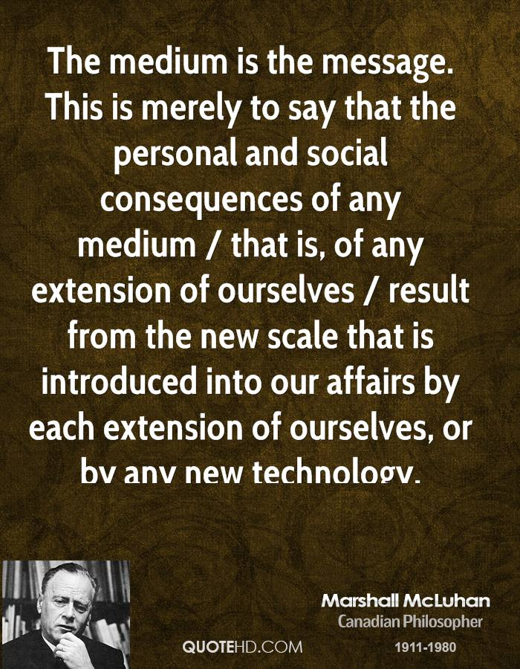
Conceptual Analysis
“When we see a landscape we situate ourselves in it. When we see a representation of the past we situate ourselves in history.” - John Berger, 1972

Slide 5
Concerns for Representing Uncertainty
Photorealistic images tend to leave their viewers with the impression that the objects depicted actually exist
Visualization technology forces clear cut decisions
Usually no support is made to confirm or check consistency to design decisions
Softwares are lacking in appropriate methods & tools
Cannot cure our total lack of knowledge archeological past
Current forms often show our indecisiveness concerning an array of given possibilities
Can only aspire a plausible antiquity, not the real one
Inherent creation of cultural context, based on interpretative assumptions and choices

Slide 6
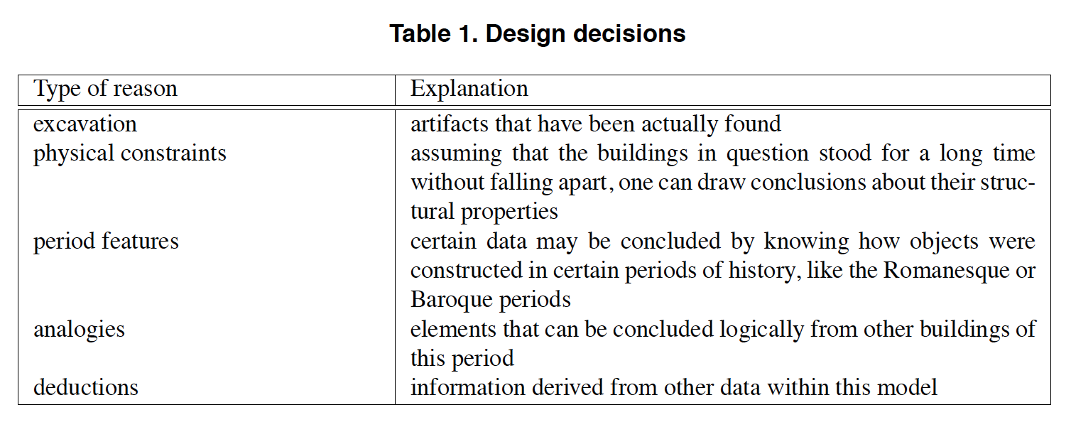
Paradata = “Learned Guessing” or “Specialist’s Intuition”

Slide 7
Problems with the 2D GIS visualisation
Visibility : Examination of complex, multi-phased archaeological sites is hampered by the limitations of 2D visibility in GISs.
Human experience : Changing perception of space through time and human movement through space, has not been sufficiently explored in 2D GIS
Uninteresting : 2D GIS seems uninteresting to general people
Realism : The sites are commonly found in an advanced state of degradation which difficult the professional/expert analysis.
Notes:
visibility studies can be greatly enhanced, adding into analysis perspective, monument shape, and color, as well as changing levels of visibility across time and space. Early GIS-based visibility analysis focused on binary concepts of visibility—visible or not visible—based on raster (terrain) elevation values and the addition of an object’s height
alternative frameworks are necessary to advance the field and find methods to incorporate visibility into the investigation of human engagement with past environments. A truly higher level of analysis than currently available in GIS would include human movement through a landscape, human perception of changing forms during that movement, the appearance of monuments, the identification of focal points, change across time, and the different textures of the natural and built environment
Integrating 3D virtual contents into AR environment could represent a milestone to make Digital Cultural Heritage (DCH) more democratic and popular. The development of new digital tools has the main goal to provide users - insiders as well as non- expert public – with instruments for the knowledge and in-depth study of historical heritage.
Virtual reconstructions of such buildings aim to provide a digital insight of how these historical places could have been in ancient times. Moreover, the visualization of such models has been explored by some Augmented Reality (AR) systems capable of providing support to experts. Their compelling and appealing environments have also been applied to promote the social and cultural participation of general public.

Slide 8
Solutions
3D visualisation ; The demonstration of the relationship between cultural spaces and visibility can help to more effectively investigated in 3D environments. It can offer new insights on monumental architecture at the sites
VR : Virtual reality can make general people more interested in those sites by making them accessible to non technical people.
AR : Incorporation virtual models in AR/AV systems can be used to promote the scientific participation of the general public in culture, history or archaeology.
Notes:
This seems especially crucial for monumental architecture, whose meaning and interpretation are not based on a sole concept (such as visibility), but rather on its relationship with the landscape/environment, with surrounding structures, and with the observer. Higher levels of investigation can be broached using GIS data moved into 3D visualization platforms.

Slide 9

Paradat: What is it?
“evaluative, analytical, deductive, interpretative and creative decisions made in the course of computer-based visualization.”
Notes:
So what are they? Well, the London Charter, which from what I can tell is an authority in this field on computer based visualisations defines paradata as:

Slide 10
Paradat: What is it?
All data about how a digital visualisation was created:
Scholarly Research
Technology Used
Process of Interpreting Sources
Relation to Other Research
Makes the process of visualization transparent, replicable, and correctable
Notes:
So in other words: …<all but read slide>...
The goal is to make the decision making process clear, so other scholars can comment and assess it.

Slide 11
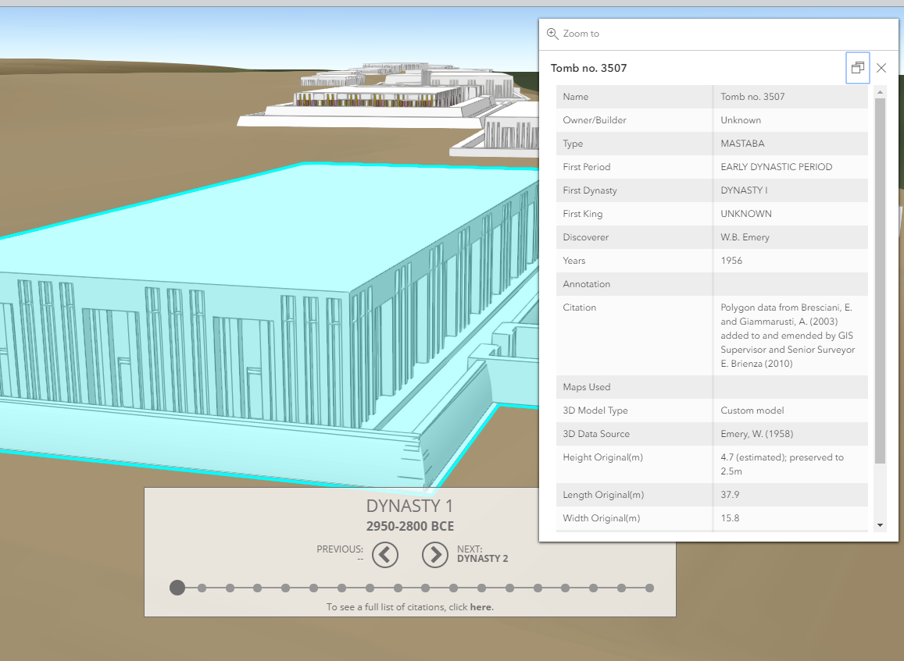
How is this currently done?
Notes:
Generally things like this:
Click on something and a window with facts pop up.
Also text in associated, but separate places.

Slide 12
Suggested proposal areas and workflow
I.e. conversation time
Timeline project ( continuous vs discrete)
Too complicated and time demanding, would need hand holding and
No clear dates recorded, dates according to julian calendar are uncertain
There isn't a spreadsheet for time on monuments and objects
Visulizing uncerintiy
complicated as a whole but doable with one or two time slices
Previously discussed :)
Would rather have a refined chunk vs more time slices
GPS markers and views
Possible project, but conversation shifted leaned towards uncertainty

Slide 13
what is the most important data?
Display data
Uncertainty data?
Represented as a quantifiable data ( from 1 - 5 or
A scale )
Ex: Sea levels as a measure of height
Hypothetical designs and metadata
Condsring:
Models, elevation, color or transparency ..etc
Always important to have the name and the date of the model
For this case specifically:
name of the dynasty
Name of king’s reign
Name of the building ( king teddy )
How it is placed in the world
Notes:
What data are you working with?- me
What does the PI want to do with the data?- beth and carrin
Does he or she have an initial idea of how to visualize the data? - mix of us
If so, what are the reasons for visualizing it?-> proof of concept for now -- Jawad
If not, what has prevented him or herfrom doing so?- too complex on some projects and lack of technical knowledge - me
Which specific analysis tasks will your visualization enable?- presentation p - present
Who will use the visualization software? Doesn’t matter in our hands muhahaha - me How generalizable is it to other researchers in the same field? In other fields?

Slide 14
Audience
Problems faced with workflow:
General public or specific( egyptologists, scholars, education) , she is open to either one depending on how the project shapes out
Goal: proof of concept
Project view: first person or overview or both
Based on our discussion:
Had to run through 4 programs
Different views for publishing and viewing platforms
Wants an end result that doesn’t require a technical person, easily viewed

Slide 15
main tools and assets
Model Assets
Models for a specific time period (TBD) - in fbx and obj formats
Materials ( different textures for uncertainty )
Needed: excel/ Cvs file for data ( if we need to present textual data)
Tools:
Engine: Unity
Unreal ( TBD)
Blender
Cityengine (TBD)
Cvs format generated from excel sheet
Notes:
Are we going to show any type of data?
Need to tlak about how we are doing this
Data
Get models - fbx and obj - ask for the original folders ( if possible ) =
Relative location instead of mapped location ( actual x,y coords) ( unity limit )

Slide 16
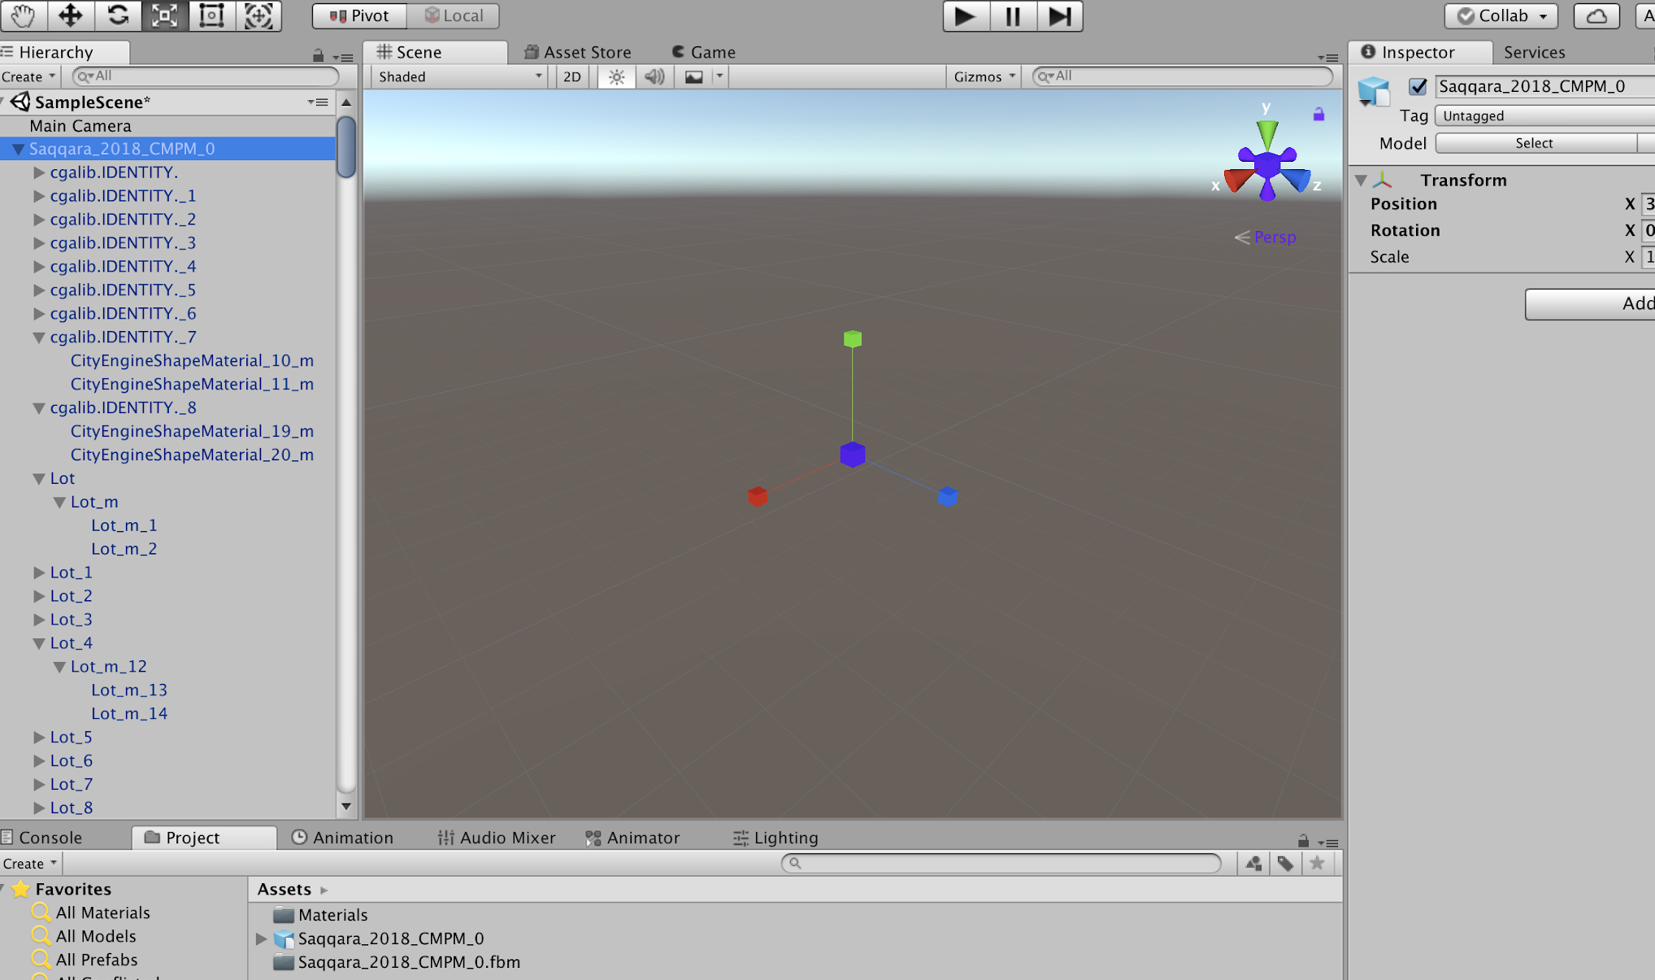
The problem?
From our conversation: Workflow mentioned issues: ( from cityengine to unity)
She mentioned that there was an issue with importing files
The hierarchy was there but the models were not visible ( in scene)
Checked for normals and materials
So what was the problem?
Notes:
Background :
VIRTUAL RECONSTRUCTION OF LOST ARCHITECTURES: FROM THE TLS SURVEY TO AR VISUALIZATION
A FRAMEWORK FOR LOW-COST MULTI-PLATFORM VR AND AR SITE EXPERIENCES
A FRAMEWORK FOR LOW-COST MULTI-PLATFORM VR AND AR SITE EXPERIENCES

Slide 17
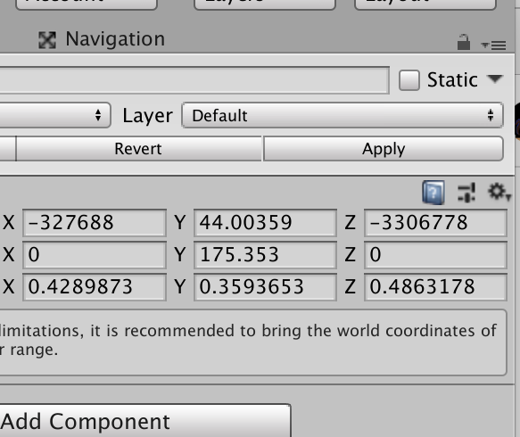
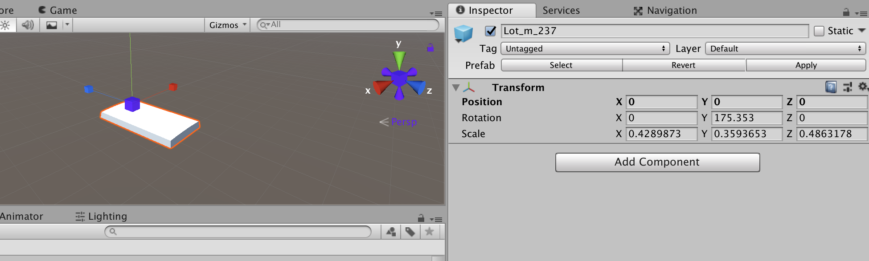
The problem? ‘Lot’ objects
Models that are defined as lots turned out to have a simple solution --- the x and y imported coordinates were to far for unity’s scene to handle.
Can’t scroll that far in unity - relative positioning option
This is for each “lot”item - 234 pieces
Maybe it was mapped to real world coordinates and attempted to translate it literally

Slide 18
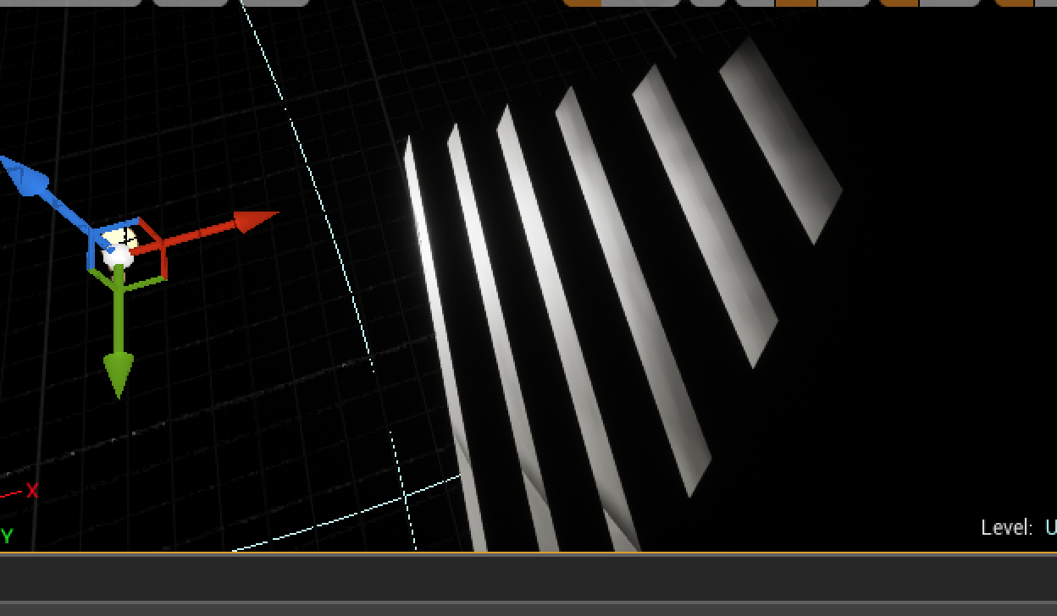
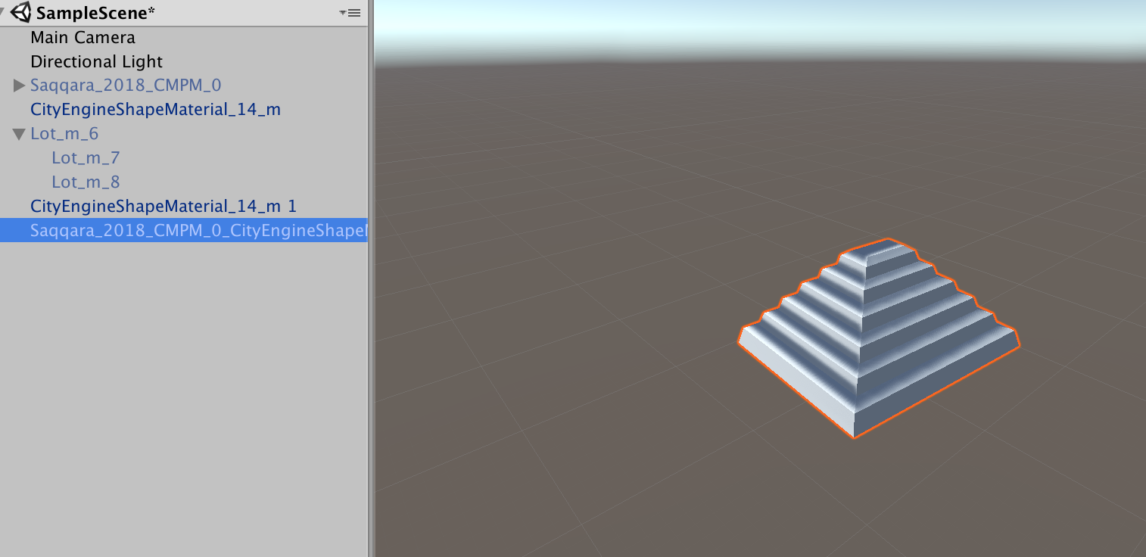
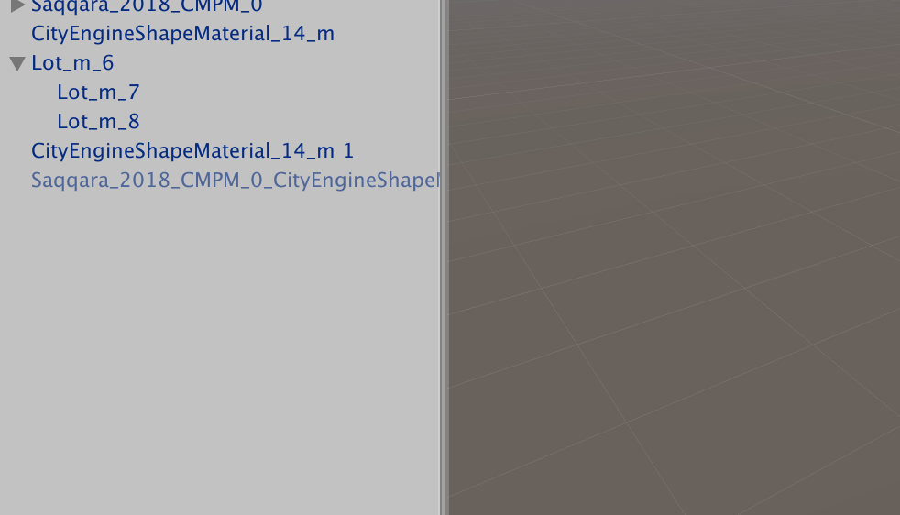
The problem?
The other type of model tagged as “identity” ( around 9 models )
Assumption: unity doesn’t allow nested imports from city engine with that specific material _ based on a forum - within unity itself, would remain invisible
Workaround - used external engine ( unreal )to re import the mode, separate it l and export it to unity - it worked but would be a hassle
The problem with this approach is we would lose relative positioning

Slide 19
Next steps
Next steps - possible solution
Get original city engine file or original models ( pre cityengine ) for the models that had these issues
Shifting to unreal but issue with unfamiliarity and time
Requesting data points, separate objects rather than one chunk
Procedurally mapping them in by reading the data of of a file rather than one big object
Come up with a relative map rather than real or too large xy coordinate
Stretch goal: having data modifiable in viewer, loading text file but modifiable in viewer( app ) as a solution to multiple approaches - (currently hierarchical model)
Needed assets and extra data:
Excel or cvs file with x,y coordinates names ( of the data mentioned earlier )
Elevation data
Original file
Your thoughts ?

Slide 20
Propose the use of 3 models as a focus bit rather than all 230+ pieces
Restructure the models in blender

Slide 21
Thank you for your time!

Slide 22
Sideris, A. (2008, October). Re-contextualized Antiquity: Interpretative VR Visualization of Ancient Art and Architecture. In T. Mikropoulos, & N. Papachristos (Eds.), Proceedings: International Symposium on “Information and Communication Technologies in Cultural Heritage”. The University of Ioannina.
Strothotte, T., Masuch, M., & Isenberg, T. (1999, February). Visualizing Knowledge about Virtual Reconstructions of Ancient Architecture. In Proceedings Computer Graphics International, Los Alamitos, CA, 1999 (pp. 36–43). The Computer Graphics Society, IEEE Computer Society.

